Slide 1
lecture 2: Introduction to Machine Learning
Instructor: Xiaobai Liu

Slide 2
Review: Machine Learning Tasks
Spam email detection
Rating movie
Book recommendation
Financial forecasting
Social network relationships
Face recognition
Scene understanding
Human tracking in videos
Self-driving car
Robot navigation
Global seismic monitoring

Slide 3
How to develop a Machine Learning system?

Slide 4
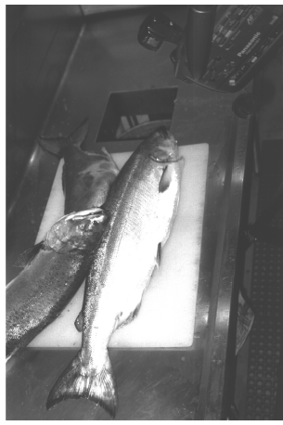
Example: Fish Classification
A classification problem:
Given a fish, could you tell if it is a Salmon or See-bass?
You are allowed to measure, observe, and touch them.
To answer this question, we need to learn expertise
From your parents
From your friends
From your textbook
Google it
…..

Slide 5
Now,
You are asked to learn on your own:
Given a bag of Fish, denoted as A, you are allowed to measure, observe, and touch them.
For every fish in A, you know its class
Could you figure out how to train yourself?

Slide 6
Get your hands dirty
For every fish in the bag A, measure its length.

Slide 7
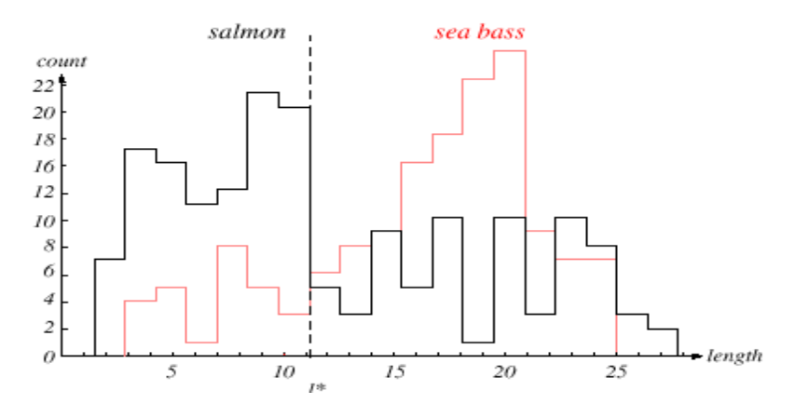
Plot what you got
count
length
Empirical boundary: separate a majority of fishes

Slide 8
With your expertise
For any new fish (not in A),
Measure its length
If it is less than “11”, it is Salmon; otherwise it is See-bass
We only use a single feature of fishes
Might be okay for simple cases
Make considerable errors when you begin to work for a fish factory
More features

Slide 9
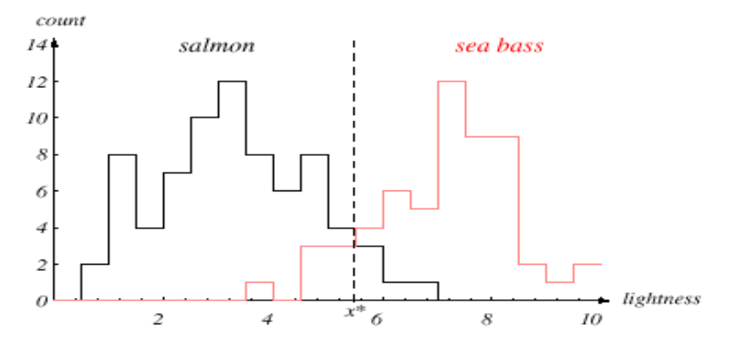
Another feature: lightness
For any fish in A, let’s measure its lightness.
Empirical boundary: separate a majority of fishes

Slide 10
With your expertise
For any unseen fish (not in A),
Measure its length
If it is less than “11”, it is Salmon; otherwise it is See-bass
Measure its lightness
If it is less than 5.5, it is Salmon; otherwise, it is see-bass

Slide 11
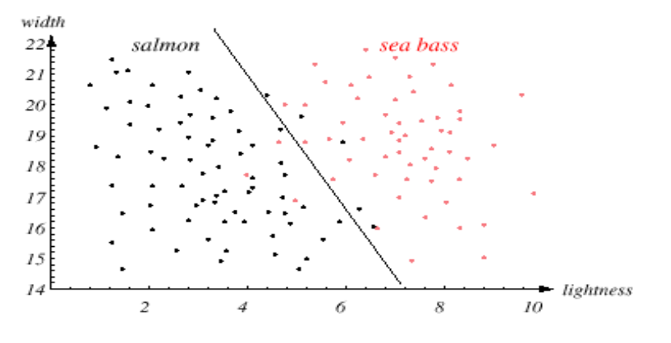
Putting two features together

Slide 12
Be careful,
Features are not equally well
E.g., number of eyes?
Any other features useless separating fish types?

Slide 13
Recap: fish classifier
Choose Features, e.g. length, lightness
Collect training samples
Choose Model (boundaries)
Estimate the model from training data
Classify new examples using the estimated model
Advanced Machine Learning methods can learn which feature is the most important one (feature selection) and decide which data to collect

Slide 14
Example Conti.
Training data
features, i.e., a vector of measurements, e.g., weight, length, color, of each fish
binary labels for each fish, e.g. for salmon, or for sea bass
Given a novel test example
Compute feature vector x;
Predict label y

Slide 15

Case: Flower Classification
Database : https://archive.ics.uci.edu/ml/datasets/Iris
Flower Types:
-- Iris Setosa -- Iris Versicolour -- Iris Virginica
1. sepal length in cm 2. sepal width in cm 3. petal length in cm 4. petal width in cm

Slide 16
Case: Autistic Spectrum Disorder (ASD)
Dataset: https://archive.ics.uci.edu/ml/datasets/Autism+Screening+Adult#
704 subjects
21 features
Classify a person to be positive (with ASD) or negative (without)

Slide 17
Attribute | Type | Description
Age | Number | Age in years
Gender | String | Male or Female
Ethnicity | String | List of common ethnicities in text format
Born with jaundice | Boolean (yes or no) | Whether the case was born with jaundice
Family member with PDD | Boolean (yes or no) | Whether any immediate family member has a PDD
Who is completing the test | String | Parent, self, caregiver, medical staff, clinician ,etc.
Country of residence | String | List of countries in text format
Used the screening app before | Boolean (yes or no) | Whether the user has used a screening app
Screening Method Type | Integer (0,1,2,3) | The type of screening methods chosen based on age category (0=toddler, 1=child, 2= adolescent, 3= adult)
Question 1 Answer | Binary (0, 1) | The answer code of the question based on the screening method used
Question 2 Answer | Binary (0, 1) | The answer code of the question based on the screening method used
Question 3 Answer | Binary (0, 1) | The answer code of the question based on the screening method used
Question 4 Answer | Binary (0, 1) | The answer code of the question based on the screening method used
Question 5 Answer | Binary (0, 1) | The answer code of the question based on the screening method used
Question 6 Answer | Binary (0, 1) | The answer code of the question based on the screening method used
Question 7 Answer | Binary (0, 1) | The answer code of the question based on the screening method used
Question 8 Answer | Binary (0, 1) | The answer code of the question based on the screening method used
Question 9 Answer | Binary (0, 1) | The answer code of the question based on the screening method used
Question 10 Answer | Binary (0, 1) | The answer code of the question based on the screening method used
Screening Score | Integer | The final score obtained based on the scoring algorithm of the screening method used. This was computed in an automated manner
Number of Instances (records in your data set): 704
Number of Attributes (fields within each record): 21

Slide 18
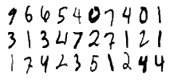
Case: Digit Recognition
10 classes: 0-9
Training photos with answers
Testing photos without answers

Slide 19
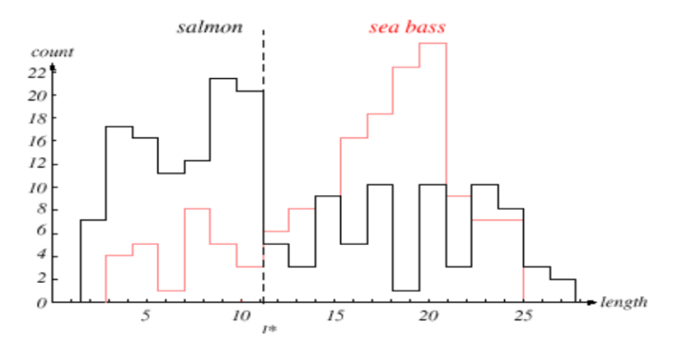
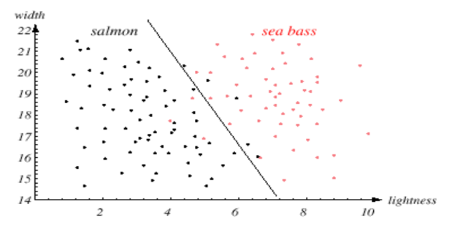
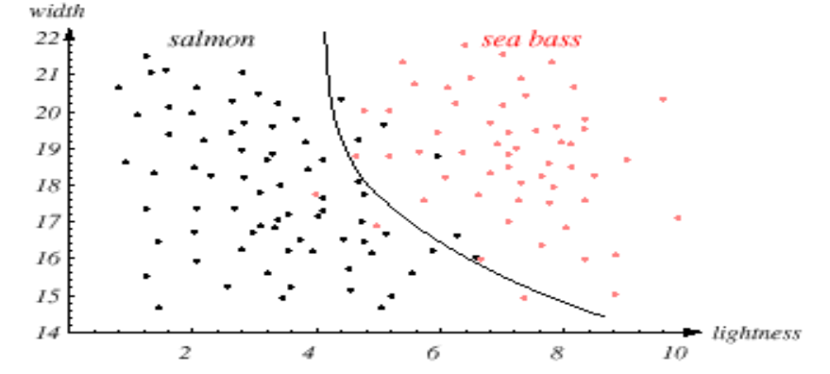
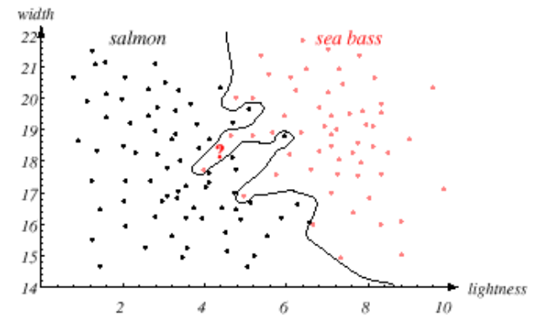
Advanced Machine Learning Models

Slide 20
Outline of the rest
Unsupervised & Supervised Learning
Typical Machine Learning problems

Slide 21
Unsupervised & Supervised Learning
Notes:
Arthur Samuel (1959). Machine Learning: Field of study that gives computers the ability to learn without being explicitly programmed.

Slide 22
Learning: Supervised and Unsupervised
Supervised learning
Training samples are input-output or feature-label pairs
Test sample has only features or inputs
The task is to predict labels
Unsupervised Learning
Training data includes only unlabeled features;
Task is to cluster data into groups

Slide 23
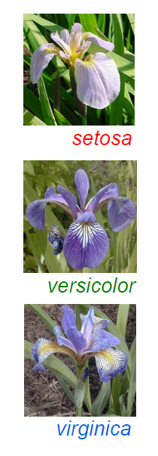
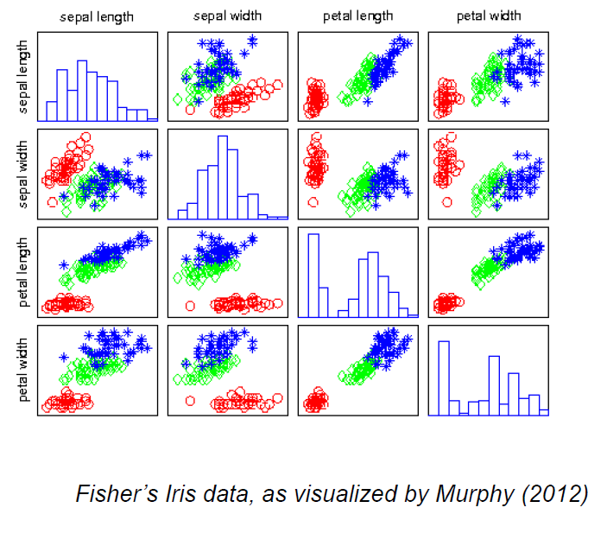
Supervised Classification

Slide 24
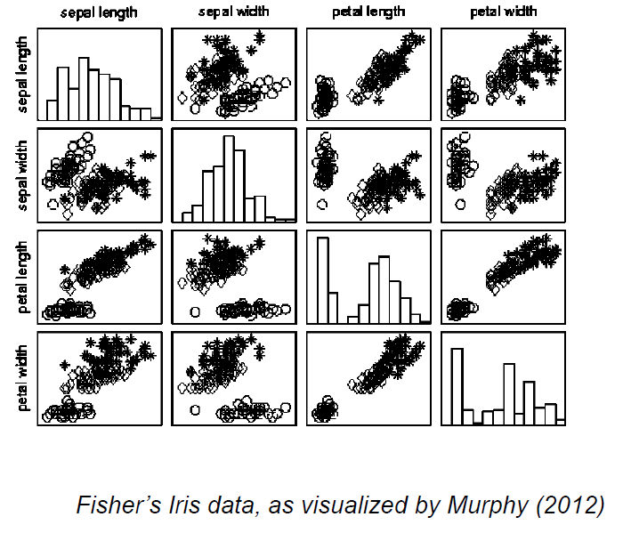
Unsupervised Classification

Slide 25
Overview: Machine Learning Problems
Notes:
Arthur Samuel (1959). Machine Learning: Field of study that gives computers the ability to learn without being explicitly programmed.

Slide 26
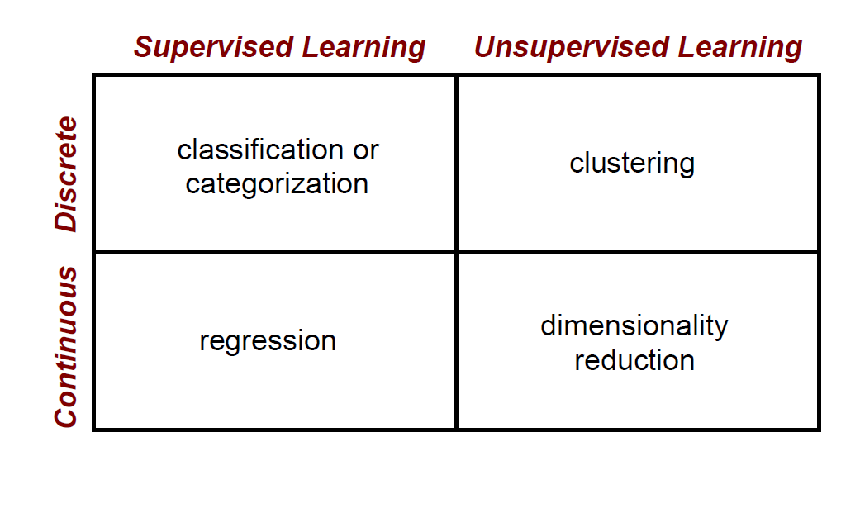
Machine Learning Problems

Slide 27
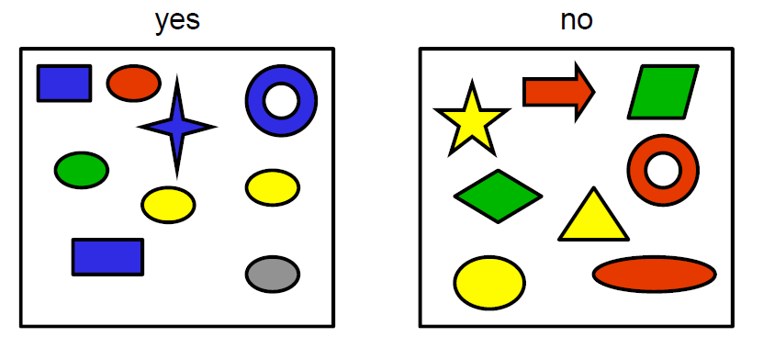

Problem 1: Classification problems
Discrete Supervised Learning
Notes:
Discrete Supervised

Slide 28
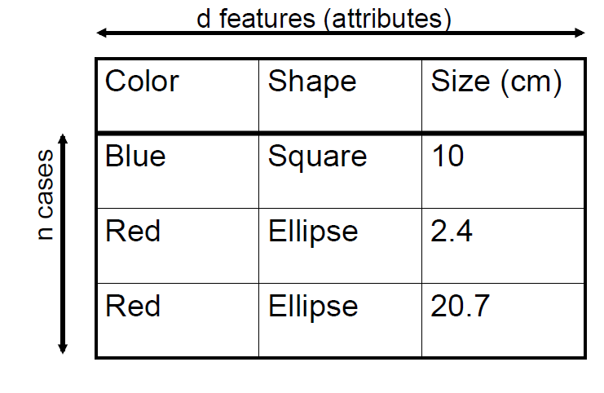

Slide 29
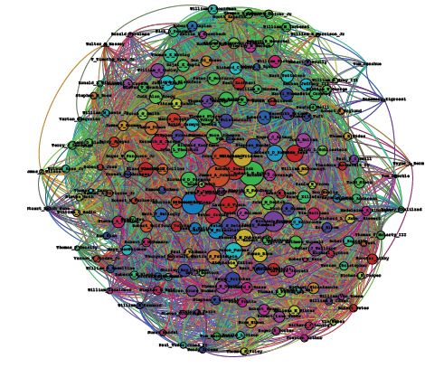
Problem 2: Clustering
Discrete Unsupervised Learning
User Activities
Community Discovery
Large-Scale Issue
Notes:
Discrete Unsupervised

Slide 30
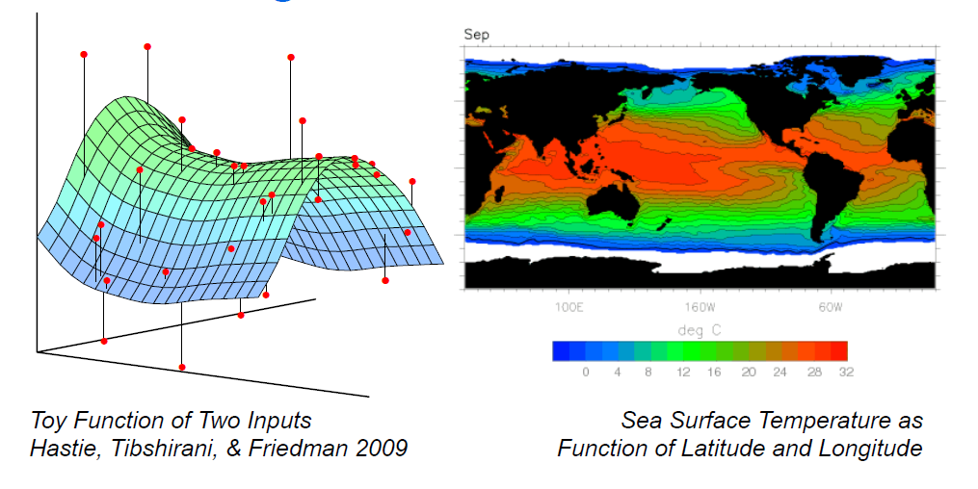
Problem 3: Regression
Continuous Supervised Learning
Label is real number, instead of discrete classes
Notes:
Continuous Supervised

Slide 31
Quiz
Of the following examples, which can be ell addressed using an unsupervised learning algorithm? (Check all that apply.)
Given email labeled as spam/not spam, learn a spam filter.
Given a set of news articles found on the web, group them into set of articles about the same story.
Given a database of customer data, automatically discover market segments and group customers into different market segments.
Given a dataset of patients diagnosed as either having diabetes or not, learn to classify new patients as having diabetes or not.

Slide 32

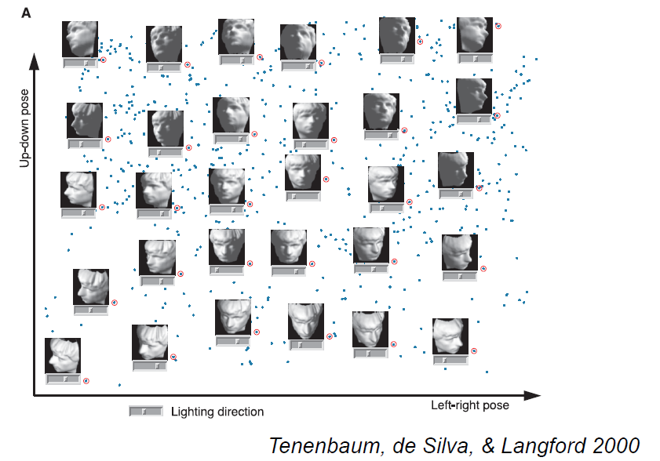
Problem 4: Dimensionality Reduction
Unsupervised Regression
Example: faces
Features of high dimension: 32pixels *32 pixels=1024

Slide 33
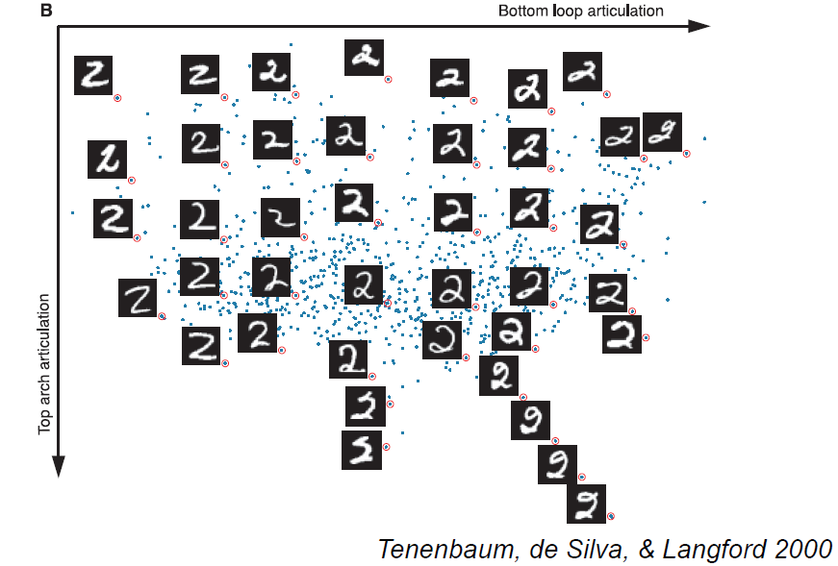
Problem 4: Dimensionality Reduction
Unsupervised Regression

Slide 34
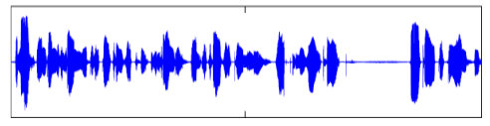
Quiz: speech recognition
From Audio Waveform, Spoken Words
Which of the following statements are not correct?
The training data are audio-word pairs
The task is to recognize spoken words for a novel audio waveform
This is an unsupervised learning problem
This is typical supervised learning problem

Slide 35
Next Lecture
Hello world, Machine Learning!

